Slide 1
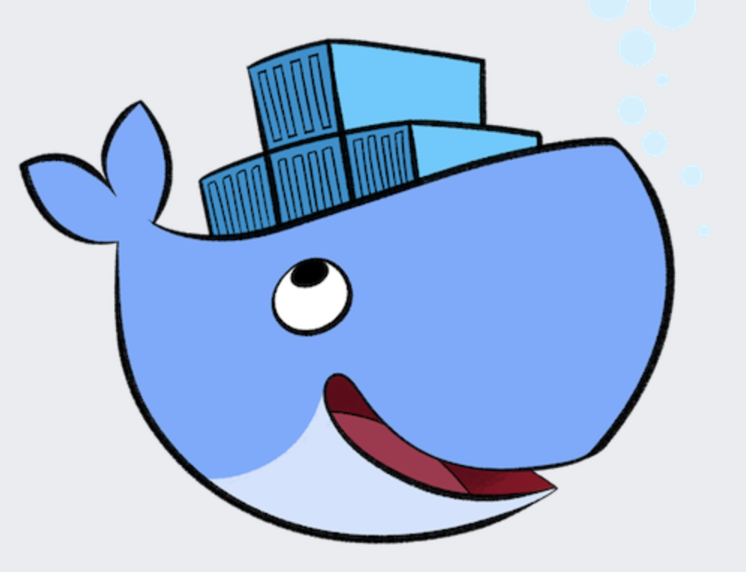
Docker containers
What is Docker?
Docker is an open platform for developing, shipping, and running applications.
Docker enables you to separate your applications from your infrastructure so you can deliver software quickly.
Unlike virtual machines (traditional virtualization) that require a full-blown OS, containers share the host system’s kernel, making them more lightweight and efficient.
What are Containers?
Containers are an abstraction at the app layer that packages code and dependencies together.
They can run on any environment, be it a personal laptop or a public cloud, ensuring consistency across environments.

Slide 2
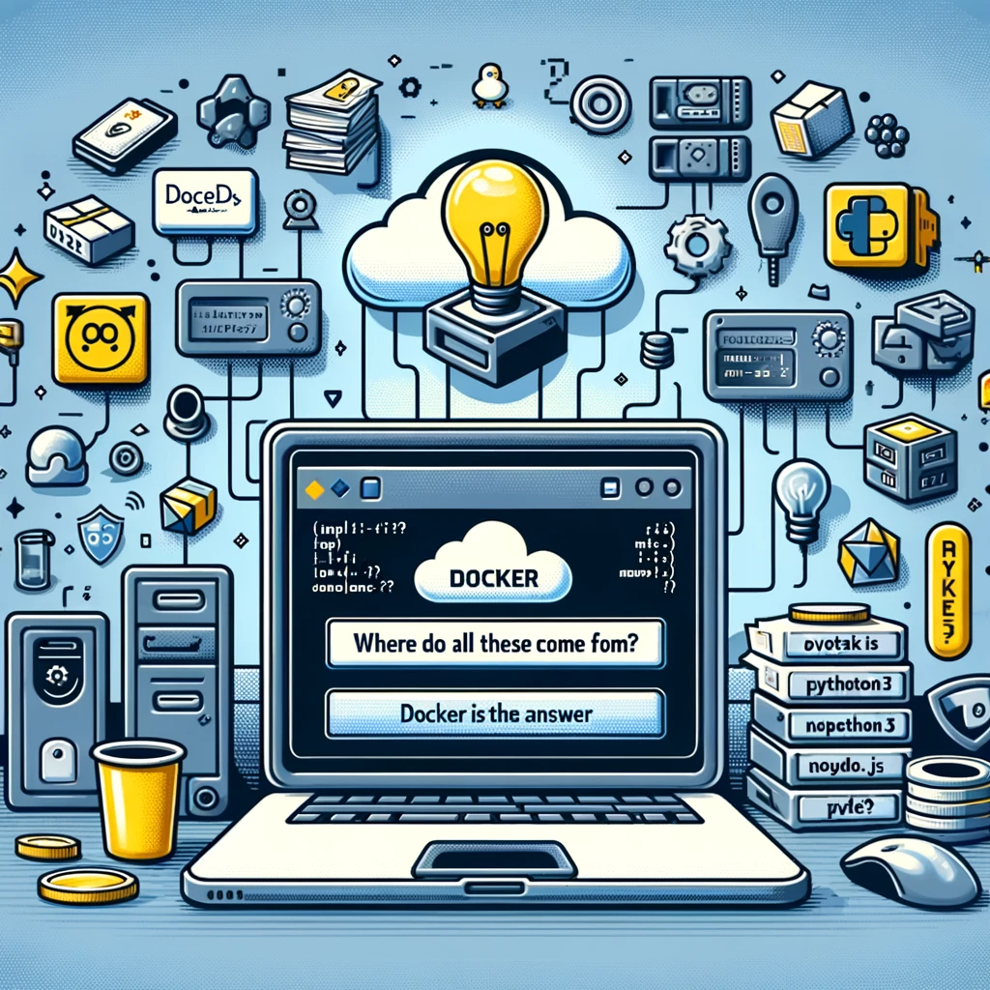
Why Docker?
Solve technical challenges
Traditional deployment methods have strict limits on the runtime environment.
Eg: AWS Lambda has as a maximum of 5 layers and 10MB for layers. This can be restrictive for complex applications.
Empowering innovation
Docker empowers developers and data scientists to innovate and experiment without infrastructure limitations, making it ideal for projects, startups, and enterprise applications.
Use Case: ML Model Deployment
ML models often require large libraries (e.g., TensorFlow, PyTorch) that exceed the limits of some platforms. This poses a challenge for deploying robust ML applications directly.
Docker containers encapsulate everything the application needs to run independently of its environment. Popular answer that solves the size and dependency constraints by packaging applications with all their dependencies.

Slide 3
Advantages of using containers
Cost Savings and Efficiency
A server can host significantly more containers than virtual machines.
Docker optimizes resource utilization, allowing more applications to run on the same hardware compared to older technologies, leading to significant cost savings.
Agility and Speed
Docker enables businesses to adapt quickly by making it easier to create, test, and deploy applications & services.
Portability
Move applications across environments from development to production without issues.
Security Aspects
Docker provides strong default isolation capabilities, reducing the risk of security issues and simplifying backup and recovery processes.
Rapid Scalability
Docker’s lightweight nature makes it ideal for microservices architecture, allowing each microservice to be scaled independently in a cost-effective manner.
Provisioning containers only takes a few seconds or less, therefore the data center can react quickly to an increase in demand.

Slide 4

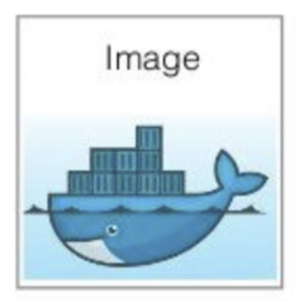
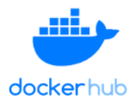
Core Concepts & Architecture
Client-server application with three major components:
Docker Images
Read-only templates used to build containers.
Docker Hub & Registries
Service provided by Docker for finding and sharing container images with your team.
Server - long-running program called a daemon process
REST API - specifies interfaces that programs can use to talk to the daemon and instruct it what to do
Command-line interface (CLI) client
Docker Engine
Containers are runnable instances of images that isolate and secure the application environment.
It is the world’s largest library (container registry) and community for container images.
https://hub.docker.com/

Slide 5
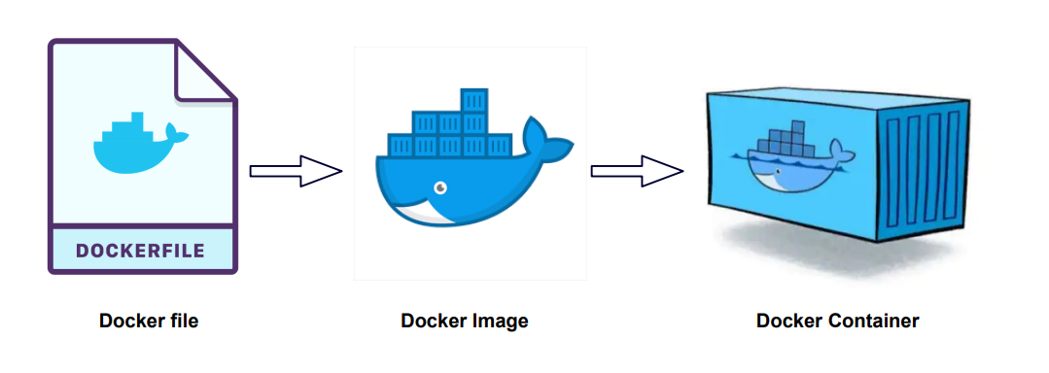
Building Docker Images
Docker can build images automatically by reading the instructions from a Dockerfile.
A Dockerfile is a text document that contains all the commands a user could call on the command line to assemble an image.
Complex docker images are usually composed from pre-existing base or parent images.

Slide 6
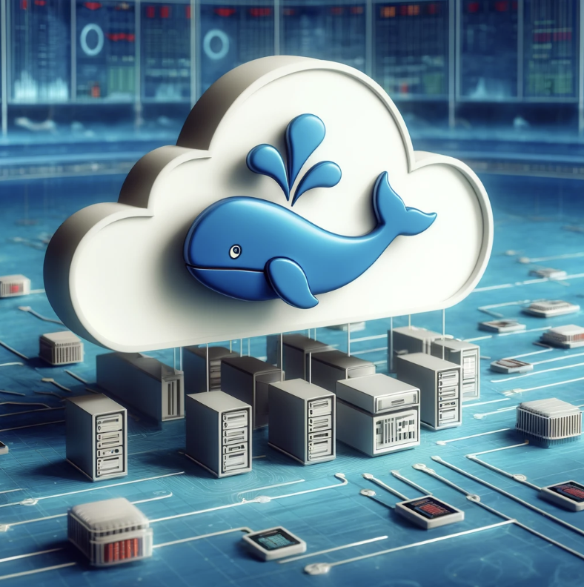
Docker in the Cloud
Since Docker ensures consistency across different environments, containers can be moved easily from local development environments to the cloud without changes.
Docker works seamlessly with major cloud providers, allowing for easy deployment of containerized applications.
AWS -> ECR, Azure -> Azure Container Instances, Google -> Kubernetes Engine.
Lambda functions can run container images. Useful for when layers are too heavy or have to use several packages.

Slide 7


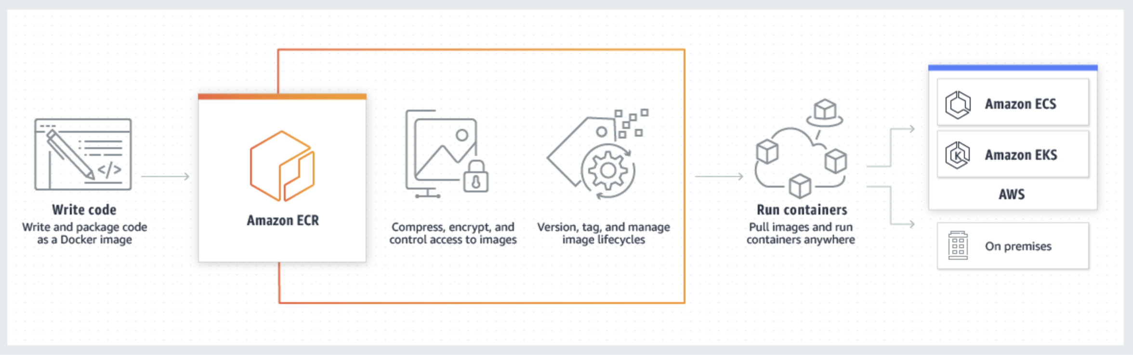
Docker in AWS
Amazon ECR
(Elastic Container Registry)
Amazon ECS
(Elastic Container Service)
ECR is AWS’ Docker container registry service that allows developers to store, manage and deploy Docker container images.
Fully managed and integrated with ECS and EKS making it straightforward to run containerized applications on AWS.
ECS is a highly scalable, high-performance container orchestration service.
Used to launch and stop container-based applications with simple API calls.
Can be launched on EC2 instances (you manage the server) or on AWS Fargate (serverless).

Slide 8
Docker Commands
Command | Usage | Example
docker run | Start a new container | docker run image_name
docker build | Build a Docker image from a Dockerfile | docker build –t image_name .
docker pull | Pull an image or repository from Docker registry | docker pull ubuntu
docker push | Push a local Docker image to a registry | docker push my_username/image_name
docker images | List all the Docker images stored locally | docker images
docker ps | Shows all running containers. Flag –a shows all containers (running & stopped). | docker ps -a
docker stop | Stops one or more running containers | docker stop container_name
Docker rm | Remove a specific stopped container | docker rm container_id
docker rmi | Remove one or more Docker images | docker rmi image_name

Slide 9
Steps for Building an App with Docker
Define application requirements.
Create a Dockerfile
Start with a base image as the operating system layer for your container
Set the working directory in the container
Copy your application code to the container using the ‘COPY’ command
Add application dependencies using Docker commands like ‘RUN’ to install necessary packages and software
Specify what commands should be run when starting the container using the ‘CMD’ command
Build your docker image based on your Dockerfile
docker build -t app_name .
Test your app running your container locally.
docker run
Push your Docker image to a container registry (like AWS ECR)
docker push app_name
Deploy to a production environment in the cloud choosing a Docker-compatible host (like AWS ECS)

Slide 10
Hands-On: Diabetes Classifier
We are going to build a Random Forest Classifier with hyperparameter tuning to predict if a female patient has diabetes or not based on certain diagnostic measurements.
The Pima Indians Diabetes Database includes the following attributes:
number of pregnancies,
glucose,
blood pressure,
skin thickness,
insulin level,
BMI,
likelihood of diabetes based family history, and
age.
Target variable: 1 if diagnosed with diabetes, 0 if not.

Slide 11
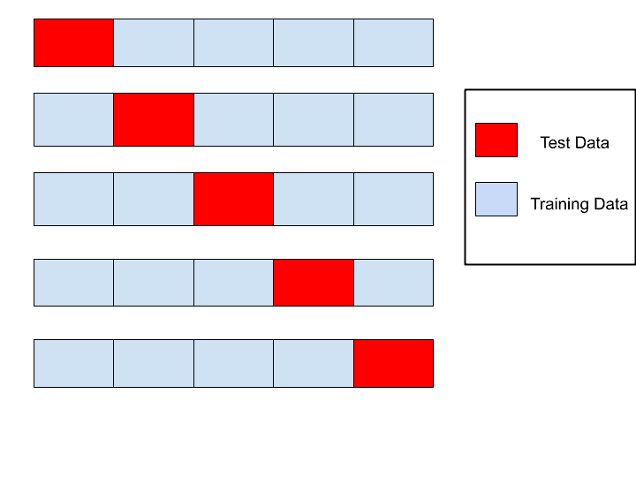

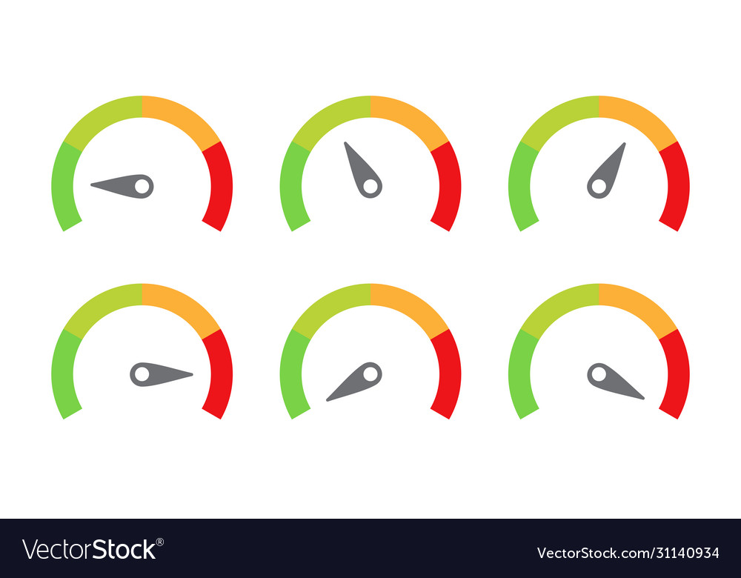

Hands-On: Diabetes Classifier
5-fold CV
Retrain using best set of hyper-params and the entire train set
Train set
Best Model
ML Model
CV model evaluation
Data set
Best model
Model evaluation with test set
Test set

Slide 12
Hands-on Part 1: Run Code Locally
If using Docker playground:
Open Docker playground (https://labs.play-with-docker.com/) and click “Start”. NOTE: If you don’t have an account, you might need to register ahead.
Click on “Add new instance”. This provides a sandbox environment to play with Docker.
If using your computer:
Open the terminal and navigate to the folder you want to work/save ths demo.
We are going to download the base code from Github. Note: In Docker Playground or similar online environments, you usually can't directly upload local files in the way you might upload files to a cloud storage service. Github is an easy way to get your code on VMs. On the terminal type:
git clone https://github.com/AlejandraLLI/MBAi460_docker_demo.git
If you type ls you should see a folder “MBAi460_docker_demo”.
Navigate to the folder typing
cd MBAI460_docker_demo

Slide 13
Hands-on Part 1: Run Code Locally
Type ls again to see the contents of the folder.
Create a python virtual environment
python –m venv .venv
Activate your virtual environment
source .venv/bin/activate
Install the required python libraries (this could take several minutes).
pip install –r run_local/requirements.txt
Run the app
python main_local.py

Slide 14
Hands-on Part 2: Local Docker Container
Navigate to the MBAI460_docker_demo/container_local folder.
Let’s create the Dockerfile. Type vi Dockerfile. This will open a terminal editor so that we can complete the Dockerfile uploaded with the code. Press ESC and type “:wq!” to save changes when finished. Remember that to create a Dockerfile you need to:
Start with a base image as the operating system layer for your container
FROM python:3.9-slim
Set the working directory in the container
WORKDIR /app
Copy your application code to the container using the ‘COPY’ command
COPY . /app
Add application dependencies using Docker commands like ‘RUN’ to install necessary packages and software
RUN pip install –r requirements.txt
Specify what commands should be run when starting the container using the ‘CMD’ command
CMD [“python”, “main.py”]

Slide 15
Hands-on Part 2: Local Docker Container
Create the docker image
docker build –t diabetes_class .
Verify that the docker image was created. You can list all docker images with
docker images
Run docker container
docker run diabetes_class
What happened to the results folder that ”appeared” when we ran the app locally?
Docker creates a separate environment and the results folder is created inside such environment, but we don’t have a way to see it … unless we mount a volume (connection) between the container and our machine.
Run the docker container again, but add a volume
docker run -v “$(pwd)/results:/app/results” diabetes_class

Slide 16
Hands-on Part 3: Docker Container in Lambda
Navigate to the MBAI460_docker_demo/container_lambda folder
The Docker file for a lambda function looks slightly different. Type vi Dockerfile_lambda to see the content of this file:
Start with a base image from AWS and specifying the platfrom
FROM –platform=linux/x86_64 amazon/aws-lambda-python:3.9
No need to define the working directory in the container
Copy your application code to the container using the ‘COPY’ command
COPY . ${LAMBDA_TASK_ROOT}
Add application dependencies using Docker commands like ‘RUN’ to install necessary packages and software
RUN pip install –r requirements.txt
Specify what commands should be run when starting the container using the ‘CMD’ command
CMD [“main.lambda_handler”]

Slide 17
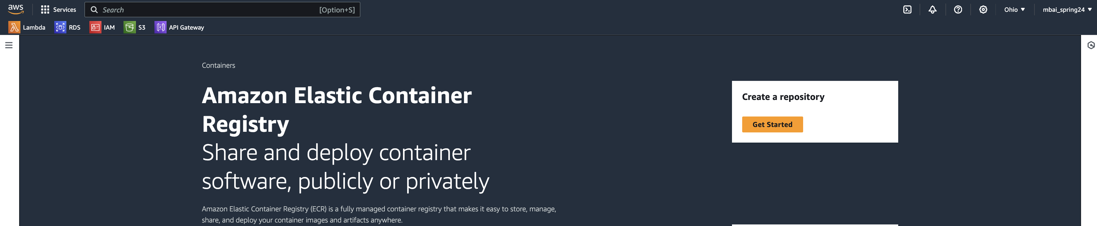
Hands-on Part 3: Docker Container in Lambda
Create the docker image
docker build -t diabetes_class_lambda -f Dockerfile.lambda .
Verify that the docker image was created. You can list all docker images with
docker images
Go to AWS and type ECR in the management console.
Select “Get Started” to create a repository.

Slide 18
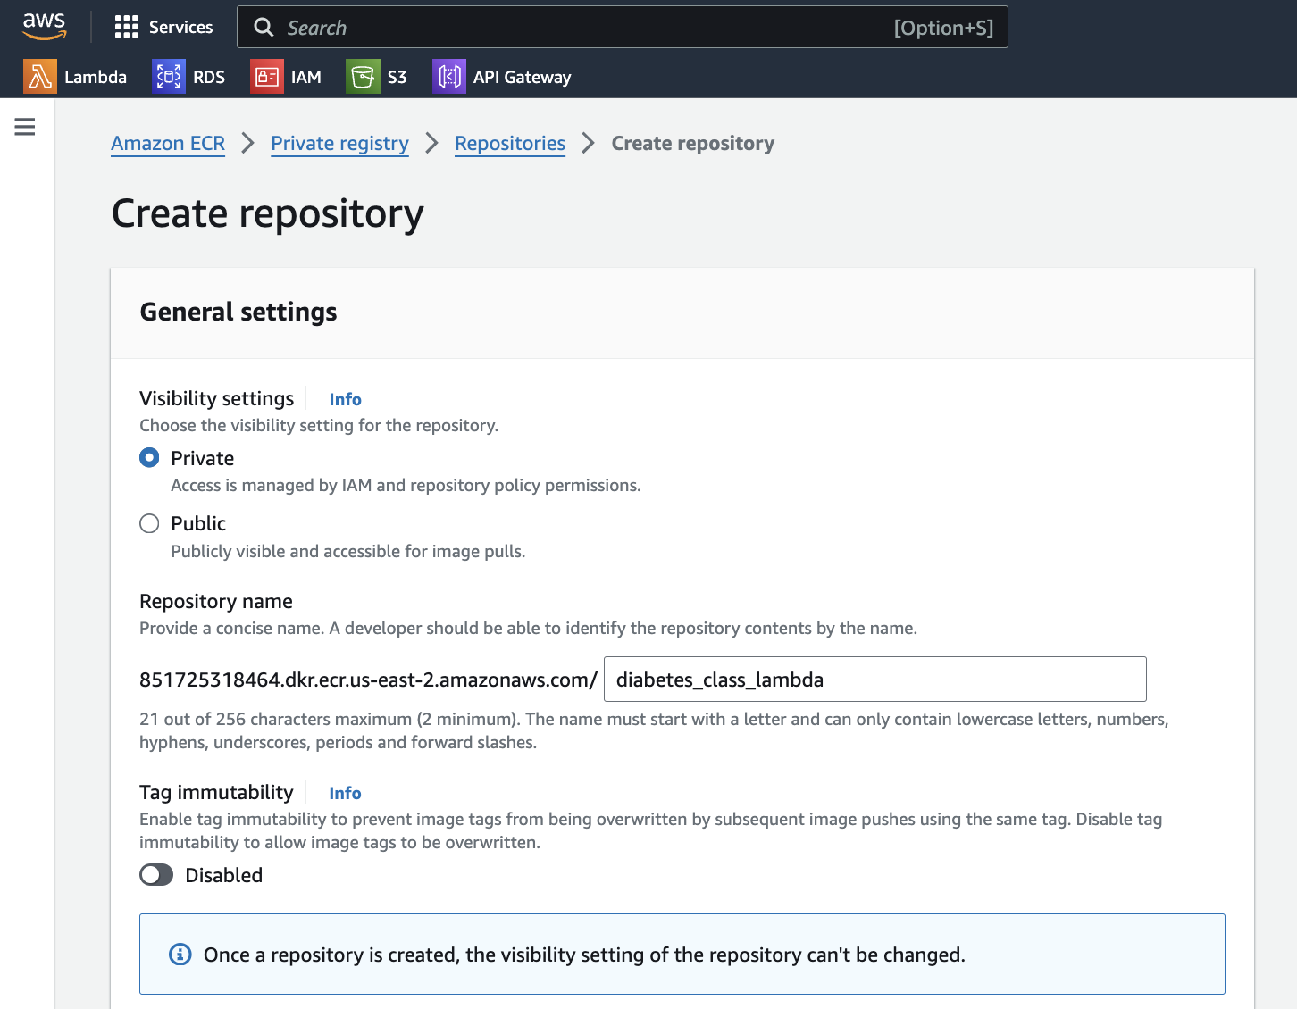
Hands-on Part 3: Docker Container in Lambda
Add the repository name to match your image name.
Leave everything else as it is and click on “Create repository”.

Slide 19
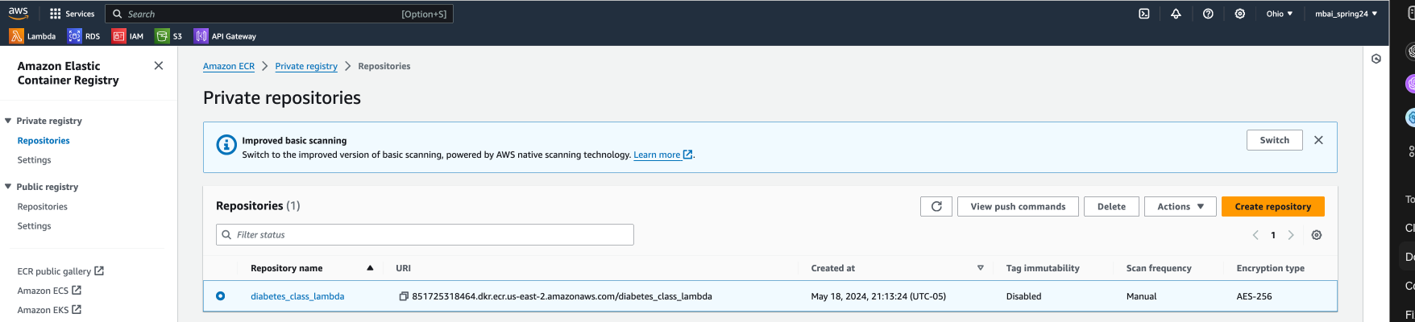
Hands-on Part 3: Docker Container in Lambda
Select your repository and click on “View Push Commands
Copy and execute the first command listed. This will retrieve an authentication token and authenticate your Docker client to ECR.
Skip command 2, we have already created the Docker image. NOTE: if you named your repository differently from the image, you need to run command 2.
Copy and execute command 3. This will tag the docker image you built as the latest version. List all the images in your docker to see the difference. You should have your diabetes_class_image and another that has the AWS registry before the image name.
Copy and execute command 4. This will push the docker image to the ECR repository.

Slide 20
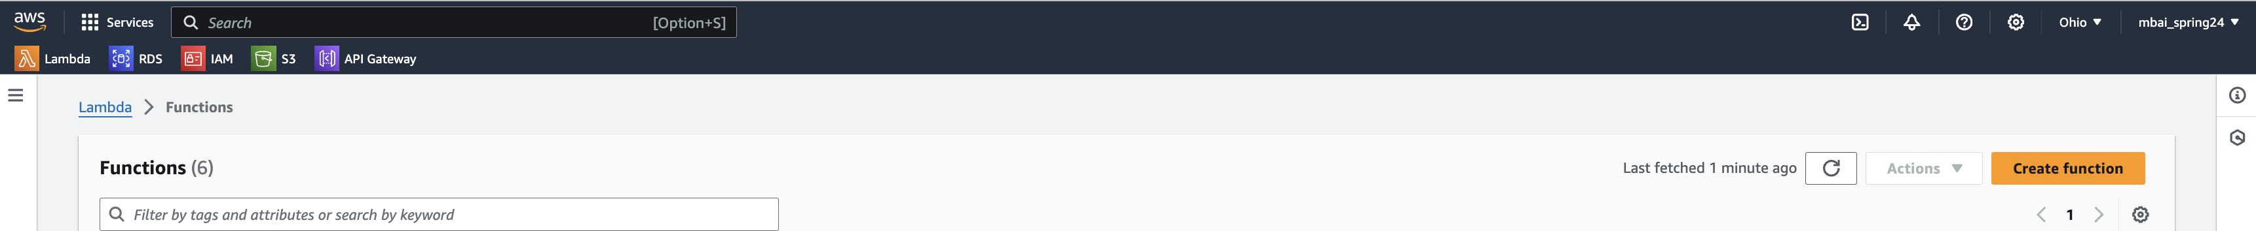
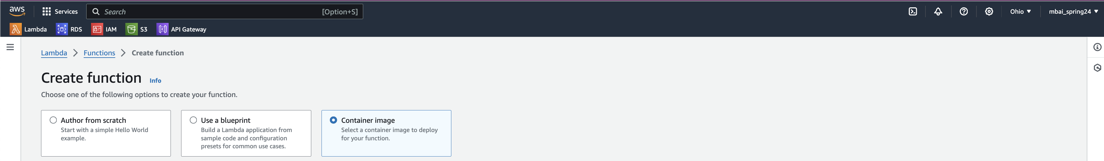
Hands-on Part 3: Docker Container in Lambda
Got to Lambda on the AWS management console and select “Create Function”
Select ”Container image”
Give a name to your function “docker_demo_diabetes”

Slide 21
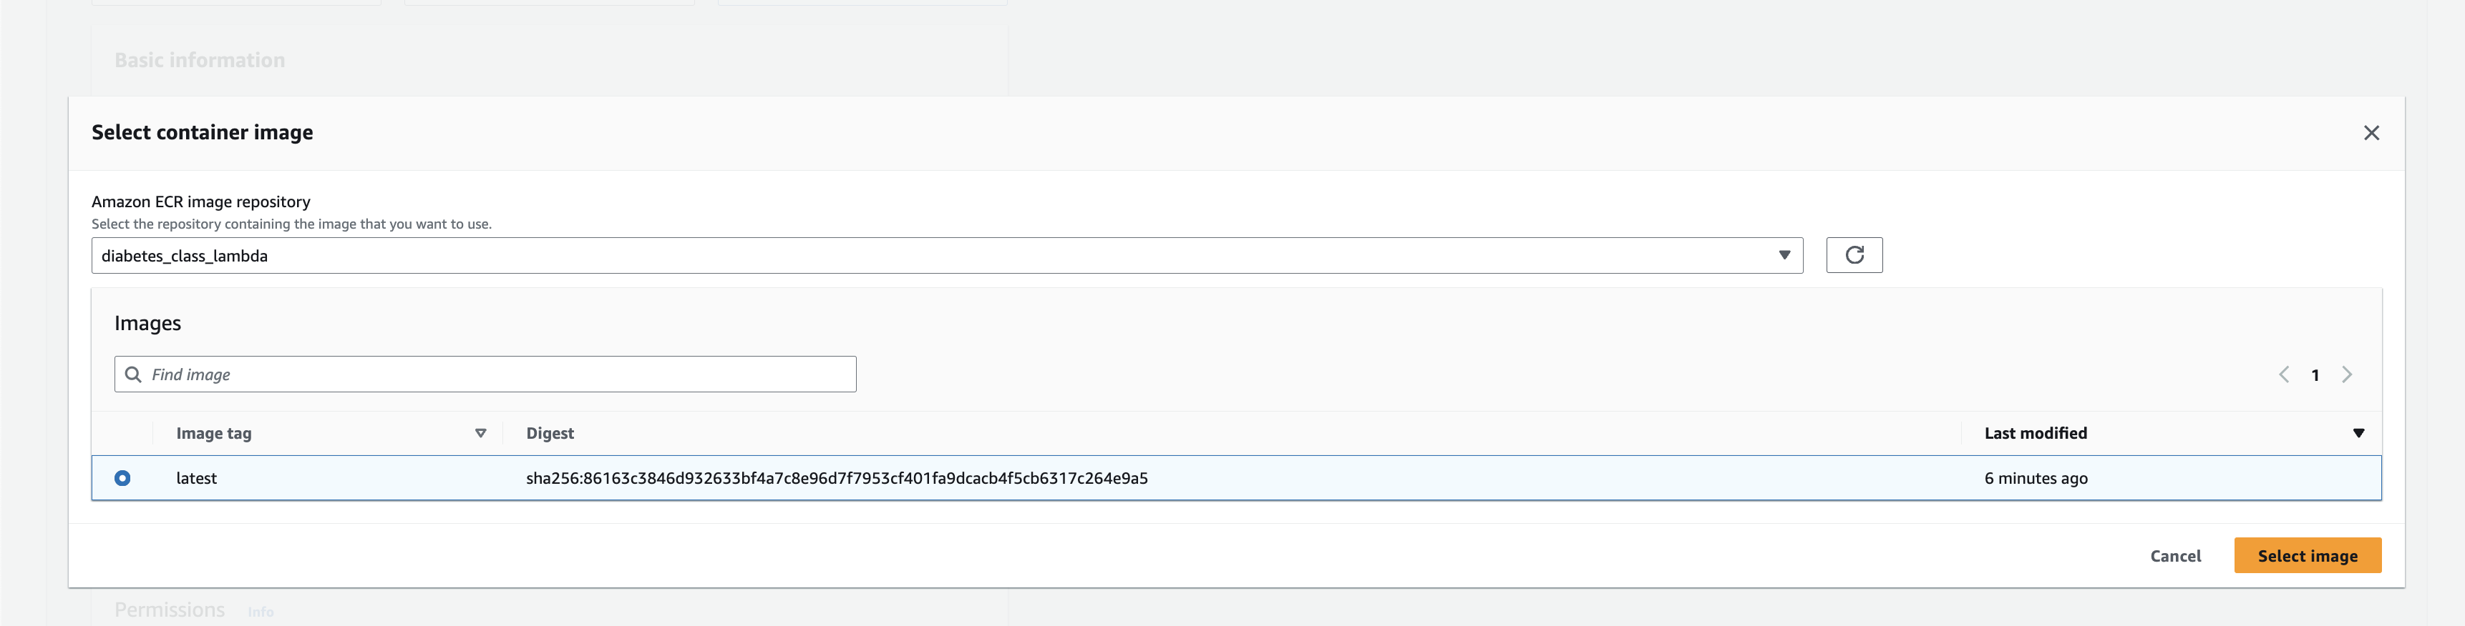
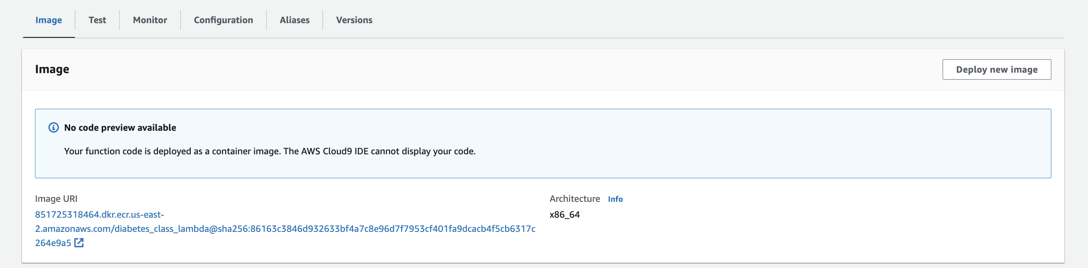
Hands-on Part 3: Docker Container in Lambda
Select “browse images” to find your container in ECR. In the dropdown menu find your “diabetes_class_lambda” image and select the latest image version. Click on “Select image”.
Click on “create function” and wait a little.
Go to configuration and increase timeout to 15 mins, and memory to 512.
Return to the Image tab, and click on “Deploy new image”.

Slide 22
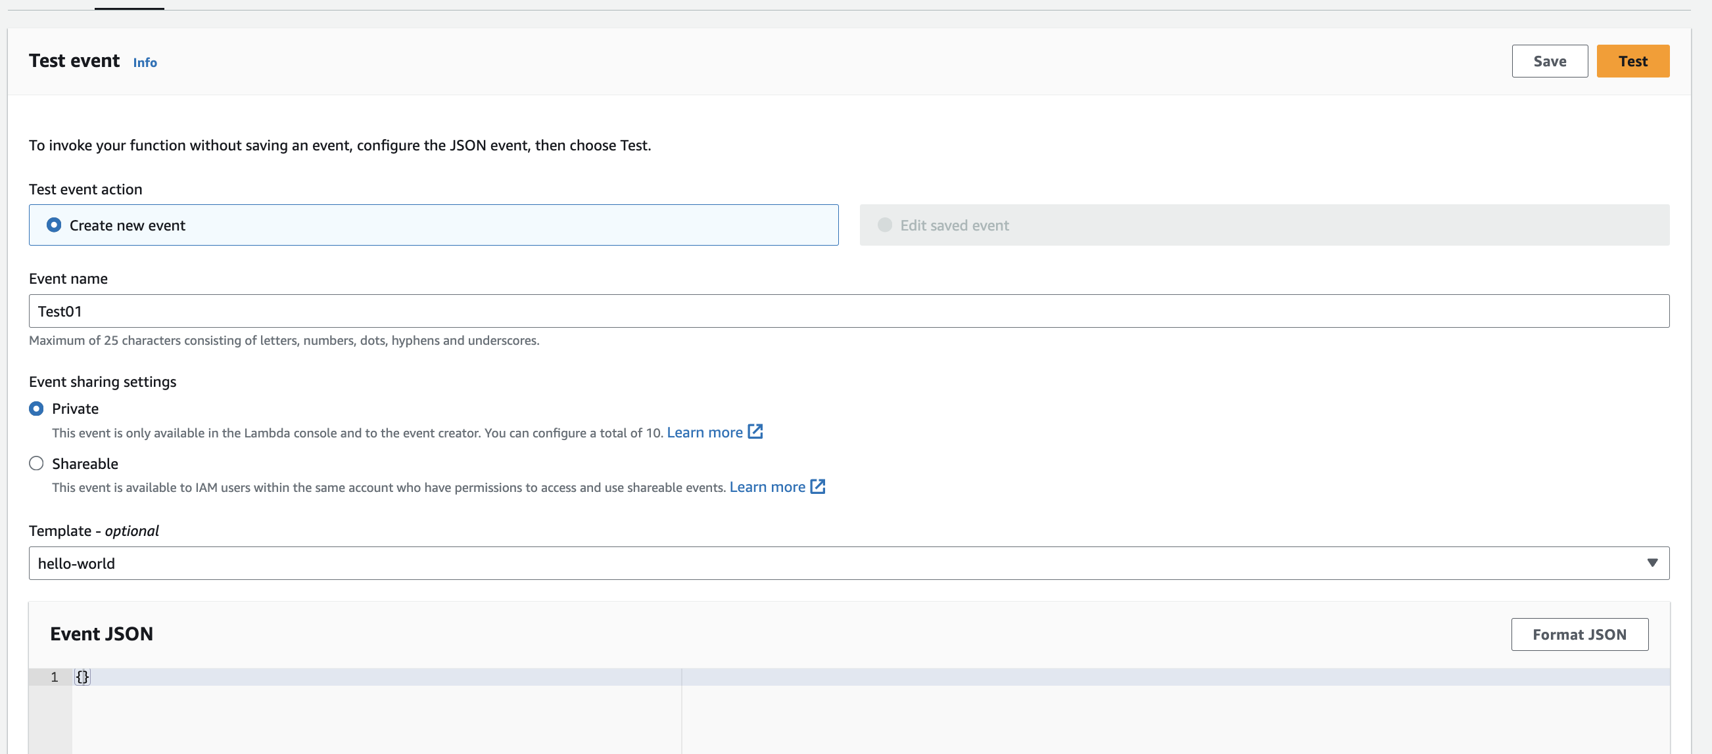
Hands-on Part 3: Docker Container in Lambda
The latest image is already selected. Click on ”Save”. NOTE: every time you make changes to your code, you need to build your docker image again, tag it & publish it to ECR and then re-deploy the lambda function selecting the newest version of the image.
Test your lambda function. Click on Test and create the event “Test01” with an empty Event JSON as shown below. Click on “Test”.
You are not going to be able to see the logs here as you do with a “normal” lambda function. Go to CloudWatch to access the logs from your test.

